Slide 1

Elicitation technique
Modeling method
Information sources
Elicit
IU info. and requirements
Design
Requirements model
Analysis
technique
Analyze
Feedback

Slide 2
Question
Generalizes, Specializes
Question
Question
Question
Answer
Supports
Position
Argument
contrary
Notes:
– “Issue Based Information Systems”, proposto por Rittel e Kunz (RITTEL; KUNZ, 1970)

Slide 3
NFR
Generalizes, Refine
NFR
Question
Question
Answer
Supports
Position
Argument
contrary

Slide 4
Roles
Process
Calls on Requirements Engineer to elicit
Participant chosen for this role.
Moderator
Moderator
Analyse sources/catalogs and create requirements
Requirements Engineers
Requirements Engineers
Negotiate and collaborate
generating new set of requirements
Customers, developers, architects and testers.
Participants
Mechanisms of
Negotiation-Collaboration
Participants

Slide 5
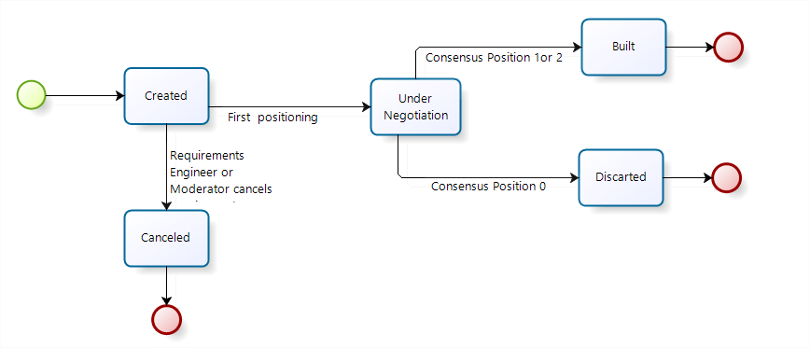
Notes:
Durante a negociação podem ser geradas diversas versões do requisito.

Slide 6
NFRX
Arguments
Doubts
Clarifications
Positioning
Requirement X v1
Refinements
Requirement X v2
Weakens
Requirement X vN
Strengthens
Arguments
Arguments
NFRY
Arguments
Doubts
Clarifications
Positioning
NFRZ
Arguments
Doubts
Clarifications
Positioning
Strengthens
Arguments

Slide 7
Decomposition
Correlation
Contribution
Goal
Correlation
Softgoal
Link Type | and | or | xor | make | help | unknown | hurt | break
Decomposition | S | S | S | N | N | N | N | N
Contribution | N | N | N | S | S | S | S | S
Correlation | N | N | N | S | S | S | S | S
Decomposition
Contribution
Task
Correlation
Decomposition
Source : Silva, 2006 [10]
Simplification
NFR
Link Type | and | or | Strengthens | Weakens | Affect
Refinement | S | S | N | N | N
Correlation | N | N | S | S | S
NFR
-
Arguments
Arguments
and
and
+
+
Softgoal
Operationalization
Arguments
+
Strengthens
NFR
NFR
Or
Refinement
NFR
NFR
-
Weakens
And
Refinement
?
Affect
OPE

Slide 8
Transparency
Trust
Awareness
+
+
+
+
Usability
+
+
+
+
Time Awareness
+
Credibility
Stability
+
Understanding
Context Awareness
+
Auditability
+
+
Self-behavior Awareness
Predictability
Social -Context Awareness
Informative
Accessibility
+
+
+
+
Controllability
Users Awareness
Content Perceptible
Content Operable
+
+
+
+
+
Secure cover with authentication function for opening for stock replenish-ment
Users Identify
Characteristics of Users
Content presented in multiple ways
Alternatives of access to application functionality
or
or
or
Face
Voice
Fingerprint recognition
+
and
and
+
Voice command access to any function or instructions
Ask characteristics of user
Adaptation to different types of users
and
Infer characteristics of user
and

